Slide 1
Multiplexed Illumination for Scene Recovery in the Presence of Global Illumination
Jinwei Gu¹, Toshihiro Kobayashi²,
Mohit Gupta³, Shree K. Nayar³
¹Rochester Institute of Technology, ²Canon Inc., ³Columbia University
http://www.cis.rit.edu/jwgu/research/demux
Notes:
I will present our work on multiplexed illumination for scene recovery in the presence of global illumination.

Slide 2
Direct and Global Illumination
surface
source
P
camera
Slide courtesy of Nayar, et al. 2006
Notes:
Let me first explain what is global illumination.
In this scene, the light from the source to the camera via scene point P, has multiple paths.

Slide 3
Direct and Global Illumination
surface
source
A
P
A : Direct
camera
Slide courtesy of Nayar, et al. 2006
Notes:
First, the light from the source is reflected on P and directly reaches to the camera. This is called direct illumination.

Slide 4
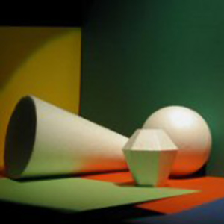
Direct and Global Illumination
surface
source
B
A
P
A : Direct
B : Interrelection
camera
Slide courtesy of Nayar, et al. 2006
Notes:
Second, the light bounces off another scene point and it’s reflected again at P to the camera. This is called inter-reflection.

Slide 5

Direct and Global Illumination
surface
source
B
A
C
P
A : Direct
B : Interrelection
C : Subsurface
camera
Slide courtesy of Nayar, et al. 2006
Notes:
The light can also penetrate the surface and scatter underneath it, come out to the camera. This is called sub-surface scattering.

Slide 6

Direct and Global Illumination
participating
medium
surface
source
D
B
A
C
P
A : Direct
B : Interrelection
C : Subsurface
camera
D : Volumetric
Slide courtesy of Nayar, et al. 2006
Notes:
If there is a participating medium such as haze and fog, this produces volumetric scattering.

Slide 7
Direct and Global Illumination
participating
medium
surface
source
D
B
A
C
P
A : Direct
B : Interrelection
C : Subsurface
camera
D : Volumetric
Slide courtesy of Nayar, et al. 2006
Notes:
All these secondary light matter interactions, they are called global illumination.

Slide 8
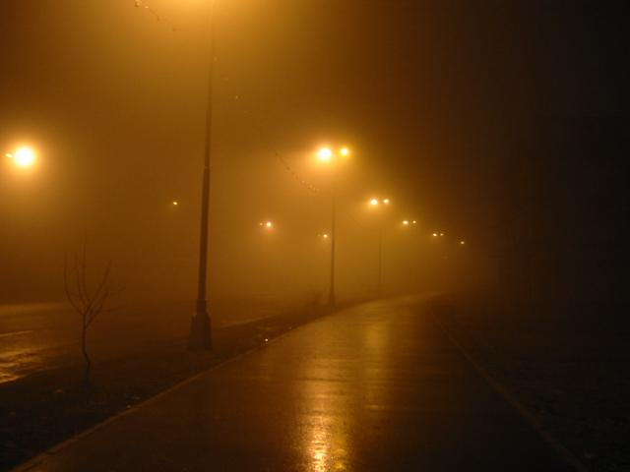




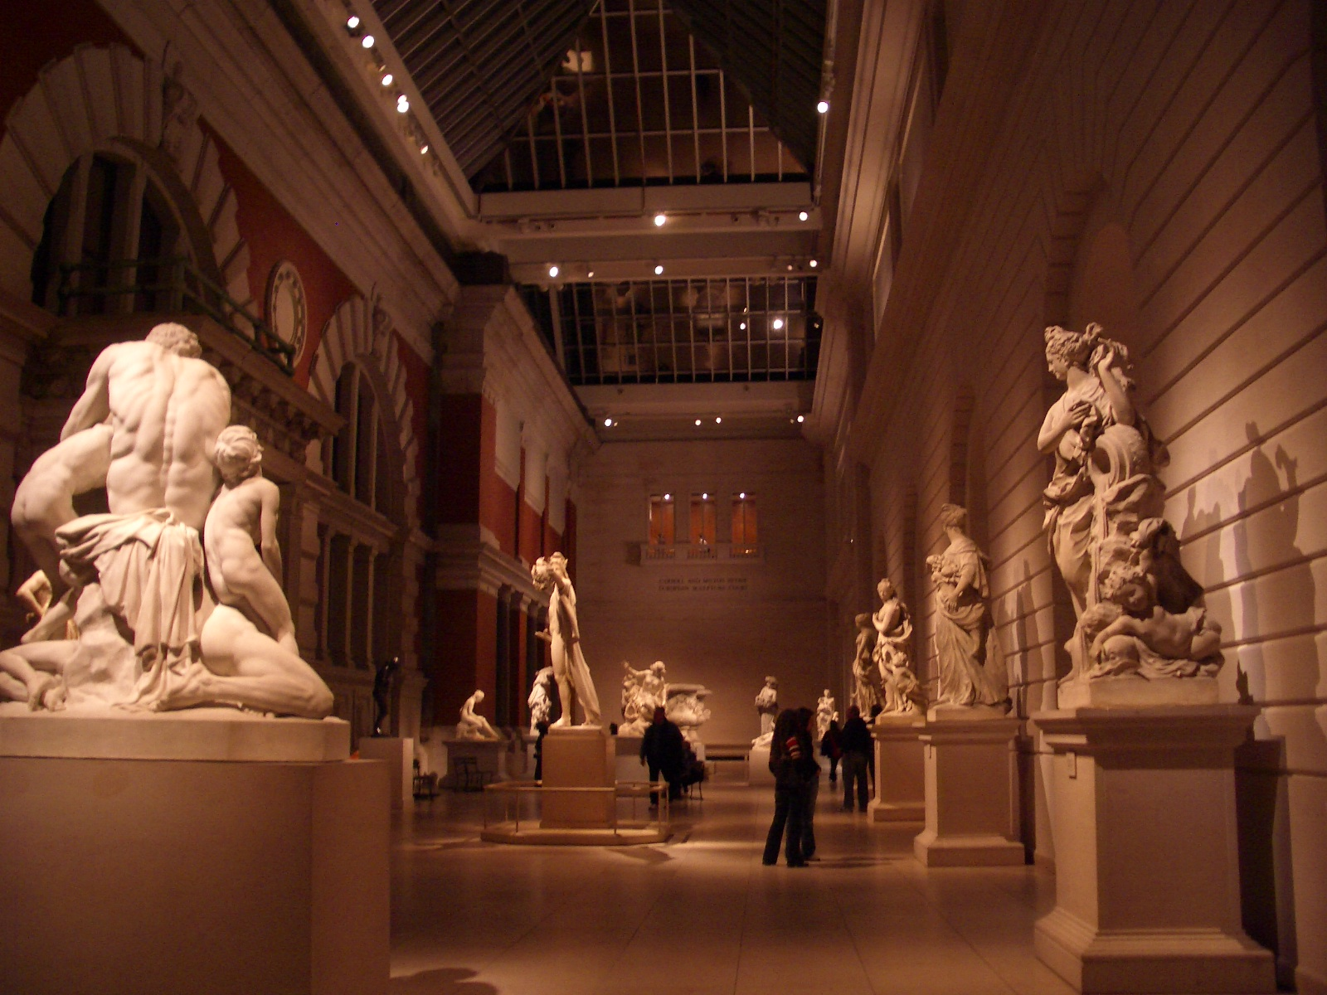


Global Illumination is Everywhere
Notes:
Global illumination is everywhere in our real world, as shown in these examples. In fact, it is nearly impossible to find a scene that does not have global illumination.
However, many computer vision algorithm often ignore global illumination and assume there is only direct illumination.

Slide 9
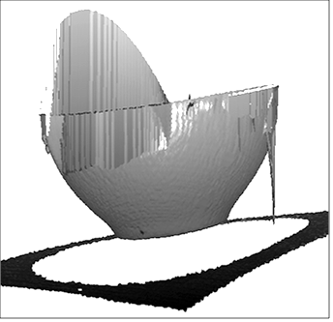
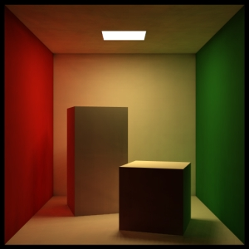
Global Illumination in Scene Recovery
Bias in shape recovery and material estimation
Error Due to
Inter-reflection
Structured Light Recovery of
a Bowl (Grey Code)
[Gupta, et al., 2010]
Color Bleeding in
Cornell Box
Notes:
If we simply ignore global illumination, we will often introduce significant errors in shape recovery and material estimation.
The left image shows an example where the inter-reflection of a bowl causes error in the depth recovery.
The right image shows the color bleeding of the Cornell box scene, yet both boxes have neutral reflectance.

Slide 10
Related Work
Direct/Global Separation for a Single Source
[Seitz, 2005]
[Nayar, 2006]
[Chen, 2008]
[Gupta, 2009] …
surface
source
camera
Illumination Multiplexing
[Harwit, 1979] [Schechner, 2003] [Ratner, 2007]
Notes:
The problem of global illumination has been solved for one light source.
In particular, Nayar et al. proposed a method which uses high-frequency light patterns to separate direct and global illumination for a single light source.
Followed up works extend this method to structured light range scanning, and take into projector defocus.
However, there is no general theory dealing with multiple light sources.
Since we are dealing with multiple light sources, our work is also related to illumination multiplexing, which shows SNR benefits by multiplexing lights and de-multiplexing afterwards. We extend illumination multiplexing in the presence of global illumination.

Slide 11
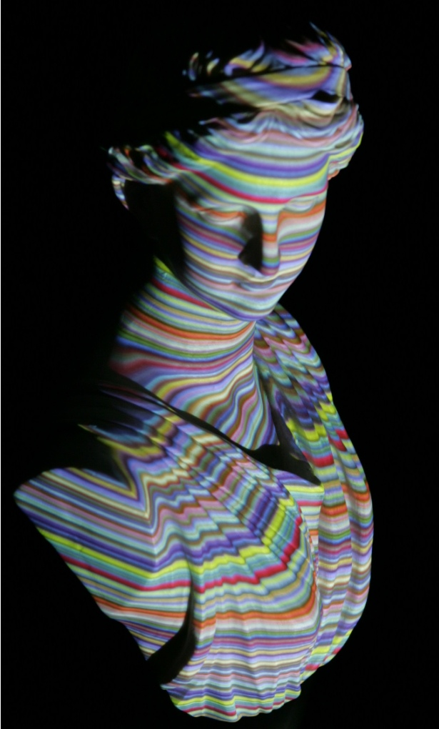
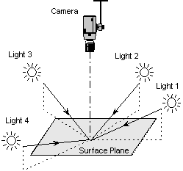
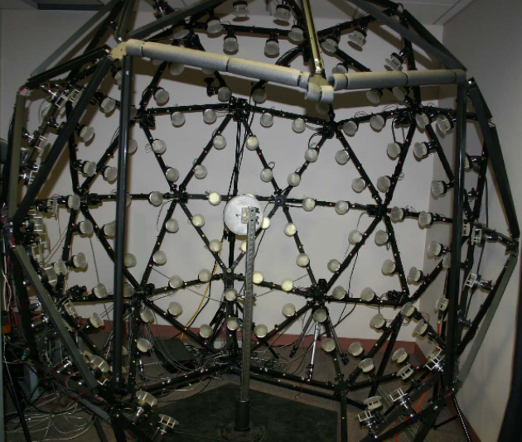
Multiple Sources for Scene Recovery
A variety of computer vision applications
BRDF Estimation
Photometric Stereo
Structured Light
Range Scanning
Notes:
Before we explain details of our algorithm, we want to emphasize there are many computer vision algorithms which require multiple light sources for scene recovery.
For example, photometric stereo requires at least 3 lights to recover surface normals.
Multiple structured light patterns are used to recover depths.
People uses multiple lights and cameras to estimate BRDFs of materials.
In these applications, how should we deal with the global illumination problem?

Slide 12
Multiple Sources: Sequential Separation
Require N times images for N light sources
Notes:
One straightforward solution is to apply the direct/global separation method for a single source sequentially for N lights.

Slide 13
Multiple Sources: Sequential Separation
Require N times images for N light sources
L1
L2
L3
Surface: V-groove
Notes:
For example, we have a V-groove scene under three lights.

Slide 14

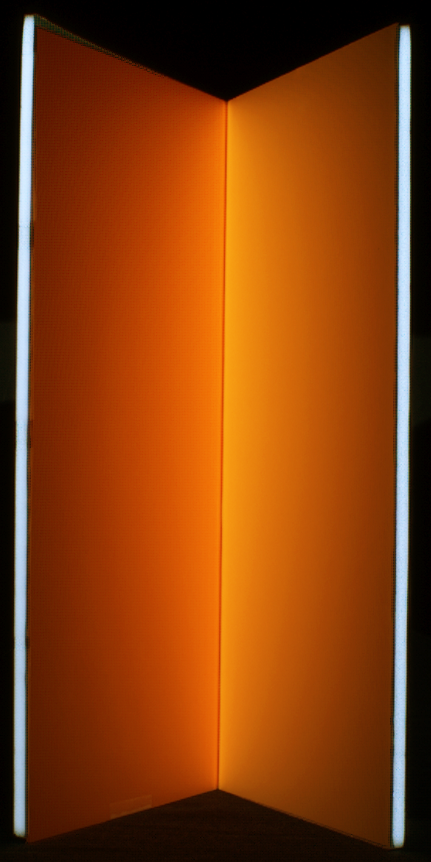
Multiple Sources: Sequential Separation
Require N times images for N light sources
L1
L2
L3
Surface: V-groove
Notes:
Once we apply the separation three times, we get the corresponding direct and global components.

Slide 15

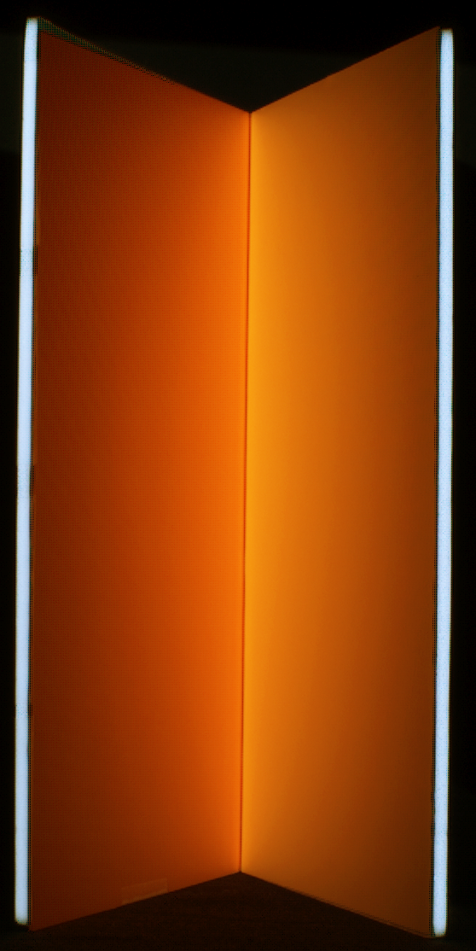
Multiple Sources: Sequential Separation
Require N times images for N light sources
L1
L2
L3
Surface: V-groove
Notes:
And repeat it for each light.

Slide 16
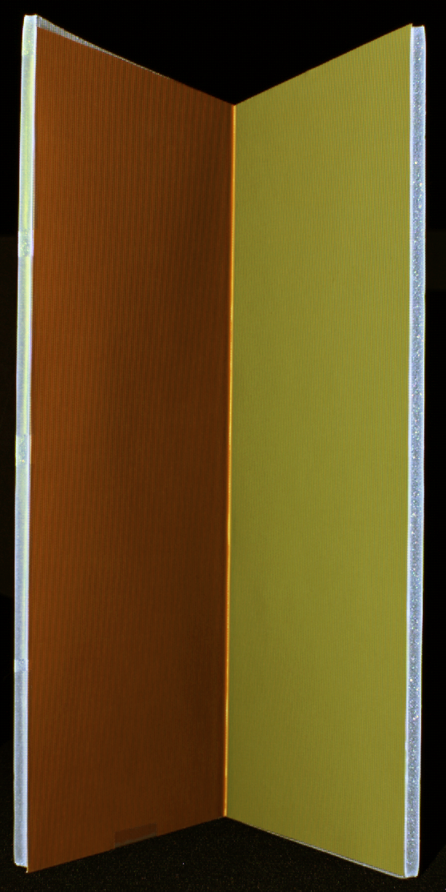
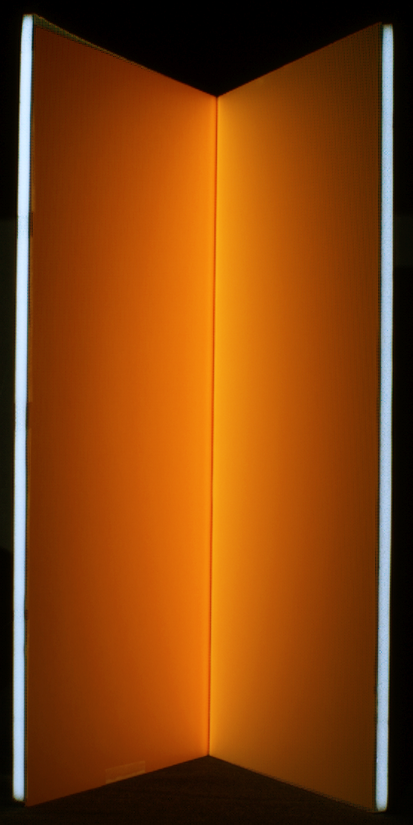
Multiple Sources: Sequential Separation
Require N times images for N light sources
L1
L2
L3
Surface: V-groove
Notes:
This will require N times images.
Can we do better than this sequential method?

Slide 17
Multiple Sources Separation: Motivation
We should do better than sequential separation, because
Notes:
We have two key observations.

Slide 18
Multiple Sources Separation: Motivation
We should do better than sequential separation, because
Only the N direct illuminations are needed for scene recovery
L1
L2
L3
Surface: V-groove
Notes:
First, for the scene recovery applications, we often only need the N direct illumination components.

Slide 19
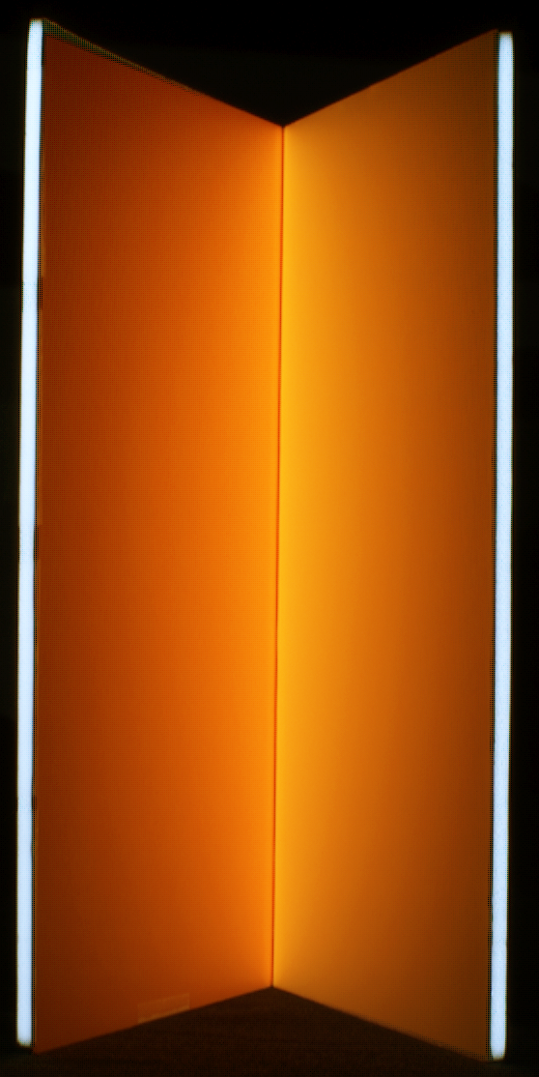
Multiple Sources Separation: Motivation
We should do better than sequential separation, because
Only the N direct illuminations are needed for scene recovery
L1
L2
L3
+
+
Sum of Global
Illuminations
Surface: V-groove
Notes:
We do not care about the global illumination. Thus there are N+1 unknowns in total. We should be able to solve for them with fewer images than sequential method.

Slide 20
Multiple Sources Separation: Motivation
We should do better than sequential separation, because
Only the N direct illuminations are needed for scene recovery
(Potential) Multiplexed advantage in SNR
L1
L2
L3
Sum of Global
Illuminations
Surface: V-groove
Notes:
Second, since we have multiple light sources, we can expect there could be multiplexed advantage in terms of SNR if we illuminate them simultaneously.
These two key observations motivate us to look into the problem of direct/global separation for multiple light sources.

Slide 21
A Theoretical Lower Bound for N Sources
N+1 images are needed to extract the N direct components
Notes:
We first found a theoretical lower bound for the number of images we need.
For N light sources, we need at least N+1 images to extract the N direct components. And if light sources can project perfect step edges, N+1 images are sufficient.

Slide 22
A Theoretical Lower Bound for N Sources
N+1 images are needed to extract the N direct components
L1
L2
L3
0.5
0.5
0.5
surface
Notes:
Here is a simple proof. We first project ½ for all lights, and capture the first image I0, which includes half the direct and half the global.
$I_0=\frac{1}{2}\sum_{i=1}^3 \left(L_d^{(i)}+L_g^{(i)}\right)$
$ I_i = \begin{cases}
I_0-L_d^{(i)}/2,\\
I_0+L_d^{(i)}/2,
\end{cases}
$

Slide 23
A Theoretical Lower Bound for N Sources
N+1 images are needed to extract the N direct components
L1
L2
L3
0/1
Binary
0.5
0.5
surface
for points not directly lit by L1
for points directly lit by L1
Notes:
Next, we change a pattern of L1 to black/white pattern and keep other lights unchanged.
Now, for points directly lit by L1, in this image, its intensities increase since they receive ½ more direct illumination from L1. For points not directly lit by L1, their intensities decreases since they receive ½ less direct illumination from L1. So we have this relationship.
$I_0=\frac{1}{2}\sum_{i=1}^3 \left(L_d^{(i)}+L_g^{(i)}\right)$
$ I_i = \begin{cases}
I_0-L_d^{(i)}/2,\\
I_0+L_d^{(i)}/2,
\end{cases}
$

Slide 24
A Theoretical Lower Bound for N Sources
N+1 images are needed to extract the N direct components
L1
L2
L3
0/1
Binary
0.5
0.5
surface
for points not directly lit by L2
for points directly lit by L2
Notes:
We have similar relations with I2 and I3.
$I_0=\frac{1}{2}\sum_{i=1}^3 \left(L_d^{(i)}+L_g^{(i)}\right)$
$ I_i = \begin{cases}
I_0-L_d^{(i)}/2,\\
I_0+L_d^{(i)}/2,
\end{cases}
$

Slide 25
A Theoretical Lower Bound for N Sources
N+1 images are needed to extract the N direct components
L1
L2
L3
0/1
Binary
0.5
0.5
surface
for points not directly lit by L3
for points directly lit by L3
Notes:
$I_0=\frac{1}{2}\sum_{i=1}^3 \left(L_d^{(i)}+L_g^{(i)}\right)$
$ I_i = \begin{cases}
I_0-L_d^{(i)}/2,\\
I_0+L_d^{(i)}/2,
\end{cases}
$

Slide 26
A Theoretical Lower Bound for N Sources
N+1 images are needed to extract the N direct components
L1
L2
L3
0/1
Binary
0.5
0.5
surface
Notes:
Now, given these N+1 images, we can estimate the direct illuminations using this equation.
$I_0=\frac{1}{2}\sum_{i=1}^3 \left(L_d^{(i)}+L_g^{(i)}\right)$
$ I_i = \begin{cases}
I_0-L_d^{(i)}/2,\\
I_0+L_d^{(i)}/2,
\end{cases}
$

Slide 27
Practical Issues and The Solution
Difficult to create sharp step edges in illumination
Cross-talk, color bleeding, screen door effect, defocus, etc.
Image intensity change is small, and sensitive to noise
Only one source changes its pattern at a time
Solutions:
Use a shifting checkerboard pattern → lots of images
Use sinusoid patterns, one temporal frequency per light
Notes:
In practice, however, it is difficult to create sharp step edges because of color bleeding and other problems. Moreover, for a large number light sources, changing only a single light will not change image intensity much and the difference will be noisy.
One could use a shifting checkerboard pattern to solve the problem of step edges, however it requires lots of images.
In this work, we proposed a method called frequency modulated multiplexing, which modulates each light with a unique temporal frequency sinusoid. It reduces the number of images needed, and it brings SNR benefits.

Slide 28
Frequency Modulated Multiplexing
Modulate each source with a high-frequency sinusoid
Move modulation pattern with a unique speed per source
L1
L2
L3
surface
Key observation:
For high-frequency illumination, the global illumination component stays unchanged when the modulation pattern shifts.
Notes:
Here is the key idea.
We modulate each light source with a high spatial frequency sinusoid so that the global illumination stays constant.
We then move the modulation patterns, with a unique speed for each light source. Note that even when the patterns move, the global illumination does not change because the light patterns have high spatial frequencies.
But since the light patterns move at different speeds, each light source has a unique temporal frequency modulation. Therefore we can separate them.

Slide 29
Frequency Modulated Multiplexing
L1
L2
L3
surface
Irradiance from sources at p at time t:
where
Notes:
Here is the detailed derivation.
This is the total irradiance the point p receives from all the sources,
$L(t) = \sum_{i=1}^N
A_i\cdot\left(1+\sin\left(\omega_it+\phi_i\right)\right)/2$
$\omega_i=2\pi f u_i$

Slide 30
Frequency Modulated Multiplexing
L1
L2
L3
surface
Radiance at p at time t:
Direct
Global
Notes:
Suppose the point P’s reflectance is R, here is the reflected radiance at point p at at time t. The first term is the direct illumination and second term is global illumination.
We can expand this term and get this equation,
where
$L(t) = \sum_{i=1}^N
A_i\cdot\left(1+\sin\left(\omega_it+\phi_i\right)\right)/2$
$\omega_i=2\pi f u_i$
$I(t) = R\cdot L(t) + \frac{1}{2}\sum_{i=1}^N L_g^{(i)}$
\\
&=\sum_{i=1}^N\left(\alpha_i\sin\left(
\omega_it\right) +\beta_i\cos\left(\omega_it\right)\right) +
\frac{1}{\sqrt{2}}\gamma
\end{split}$

Slide 31
Frequency Modulated Multiplexing
where
Linear equation with respect to the 2N+1 unknowns
cf. sequential separation with sinusoid has 3N unknowns
2N+1 images are sufficient to solve for direct components
Notes:
Alpha_i, beta_i, and gamma are defined as these.
Note that these are linear equations with respect to the unknowns alpha_i, beta_i, and gamma.
There are in total 2N+1 unknowns and thus 2N+1 images are sufficient to solve.
((Of course, alpha_i and beta_i are related.))
$\alpha_i=L_d^{(i)}\cos(\phi_i)/2$
$\beta_i=L_d^{(i)}\sin(\phi_i)/2$
$\gamma=\sum_{i=1}^N\left(L_d^{(i)}+L_g^{(i)}\right)/\sqrt{2}$
$L_d^{(i)}=2\sqrt{\alpha_i^2+\beta_i^2}$

Slide 32
Frequency Modulated Multiplexing
Multiplexing Matrix F
Notes:
We can write these 2N+1 linear equations in matrix form. Here is the multiplexing matrix F.
An interesting question to ask is what are the optimal frequencies and timings to use.

Slide 33
Frequency Modulated Multiplexing
Multiplexing Matrix F
Optimal Condition: if the frequencies and timings satisfy
the matrix F becomes an orthogonal matrix with the minimum
condition number 1.
(Please refer to the paper for detailed proof.)
Notes:
We prove that as long as the frequencies and timings satisfy this condition, the matrix F becomes an orthogonal matrix with the minimum condition number 1. Please refer to our paper for detailed proof.

Slide 34
Experimental Results
Notes:
Here I’d like to show you some experimental results.

Slide 35
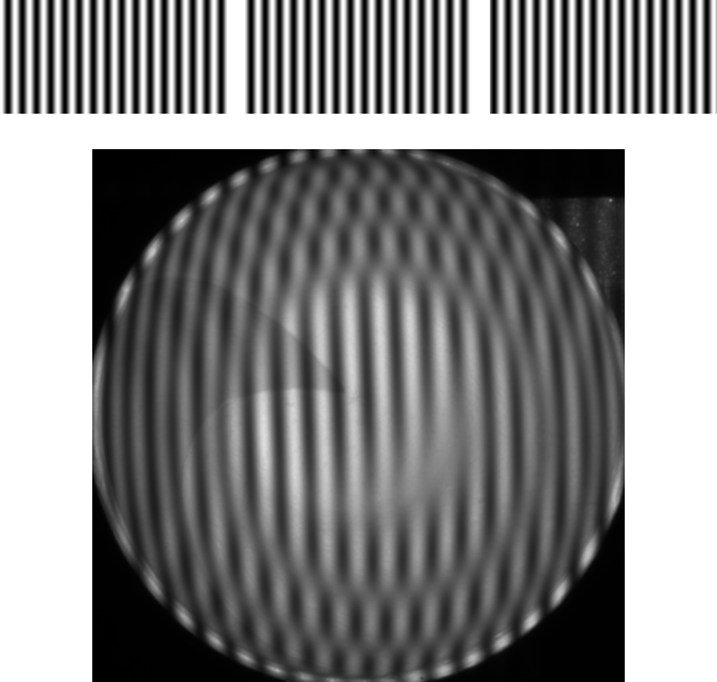
Light 1
Light 2
Light 3
Projected
Patterns
Captured
Images
Input: 3*2+1=7 images
Notes:
Here is an example of a concave bowl.
Here are the input 7 images. The top shows the modulated light patterns. The bottom shows the captured images.

Slide 36
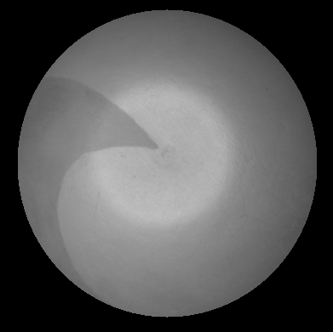
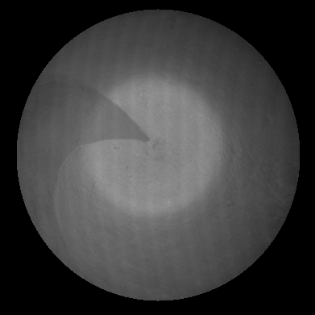

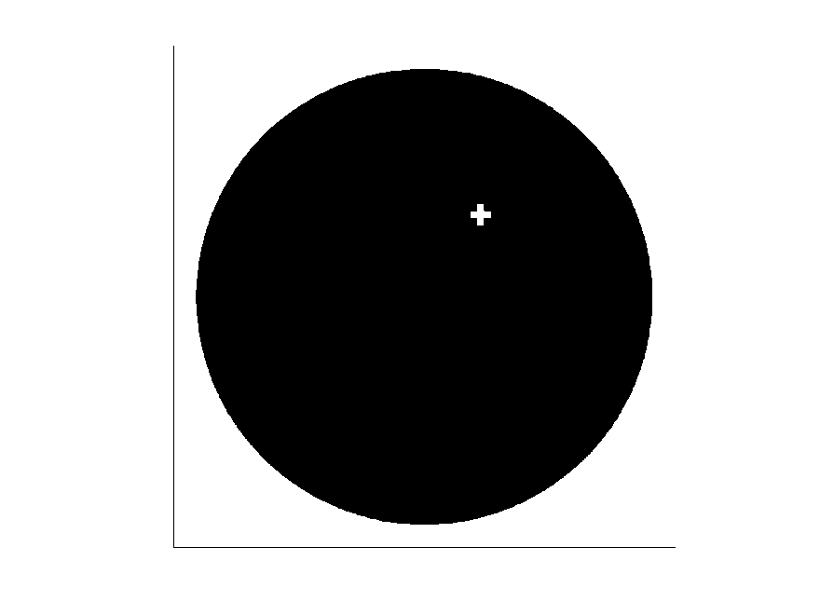
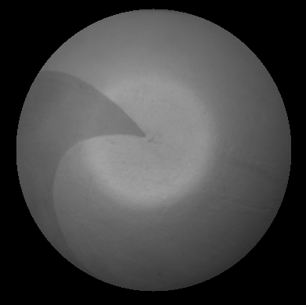
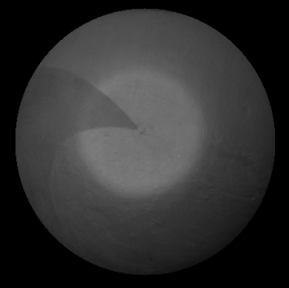
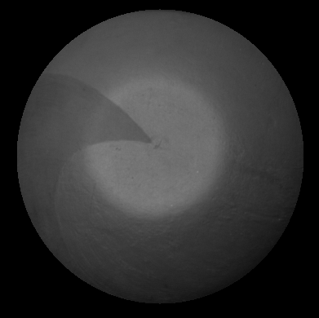
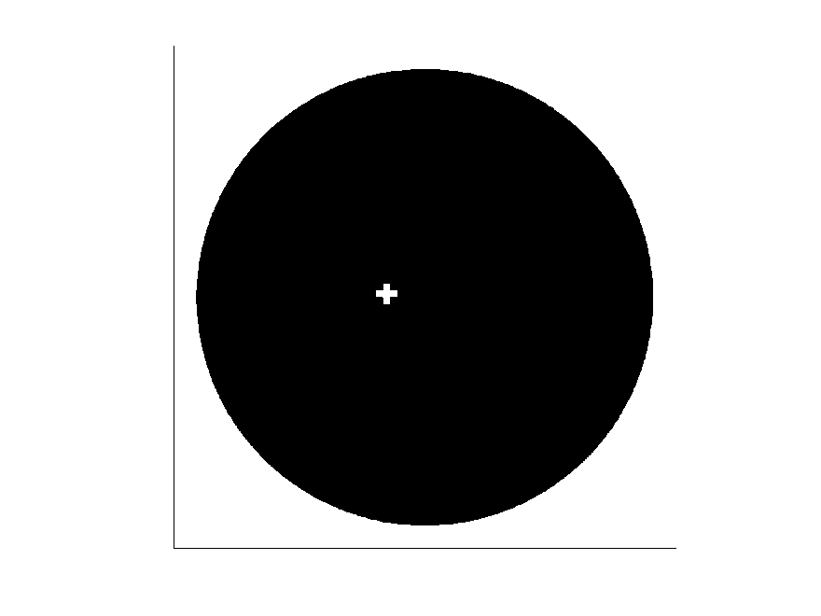
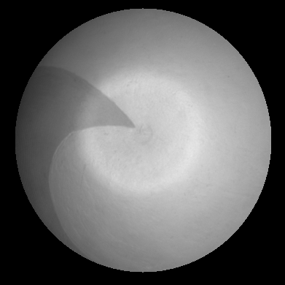
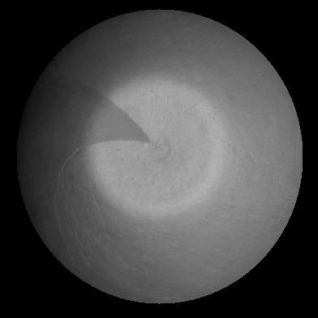

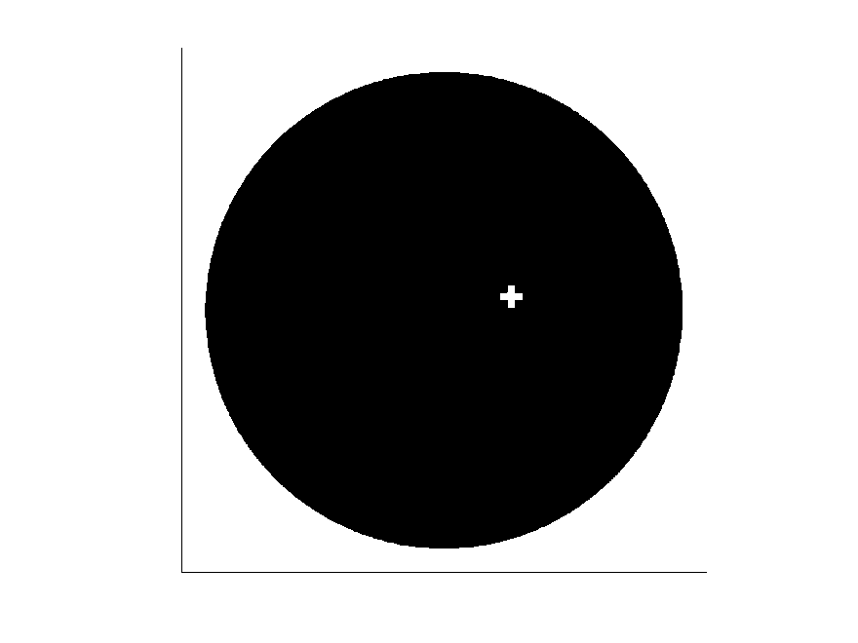
Light 1
Light 2
Direct Illumination
Light 3
No Separation
Sequential Separation
[Nayar 2006]
Our Method
Notes:
Here are the direct components.
In comparison, we show the results of sequential separation method which need 9 images.

Slide 37



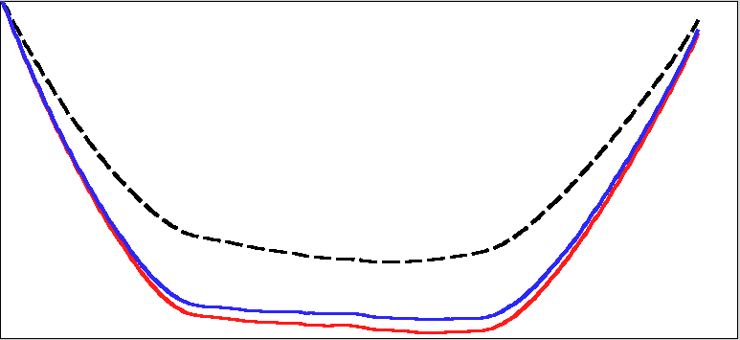
Estimated Normal and Depth Profile
No Separation (3 images)
Sequential Separation
[Nayar 2006] (9 images)
No Separation
Sequential
Ours
Our Method (7 images)
Depth Profiles
Notes:
Here we show the recovered normal maps and depth profiles.
Our method uses fewer images and recovers better results.
We can notice an artifact on the sequential separation result, it shows a SNR benefit of multiplexed illumination.

Slide 38
SNR Analysis
Similar conclusions as conventional light multiplexing
For dim light sources, SNR gain is
For bright scenes, no SNR benefit for multiplexing.
(Please refer to the paper for detailed derivation.)
Notes:
We also analyzed SNR benefits of the proposed frequency modulated multiplexing. We obtain similar conclusions as conventional light multiplexing.
For dim light sources, we can have SNR gain of sqrt(2N+1)/sqrt(3).
For bright scenes where photon noise dominates, there is no SNR benefit of multiplexing.
Please refer to our paper for detailed derivations.
$\mbox{Trace}\left((\mathbf{F}^T\mathbf{F})^{-1}\right)-(\mathbf{F}^T\mathbf{F})^{-1}_{2N+1,2N+1}=\frac{4N}{2N+1}$

Slide 39
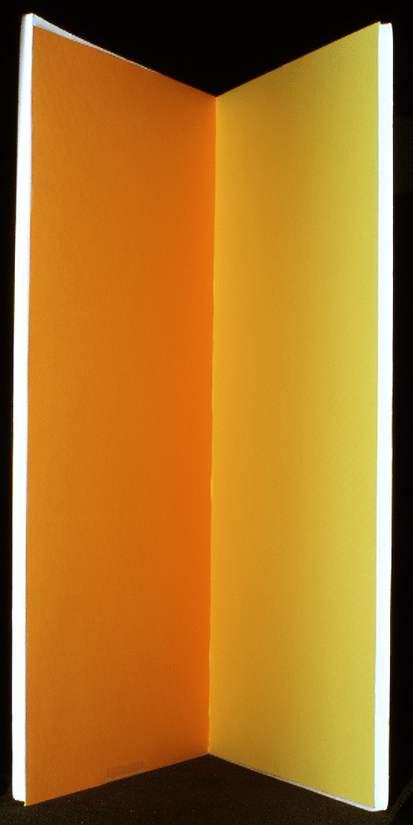
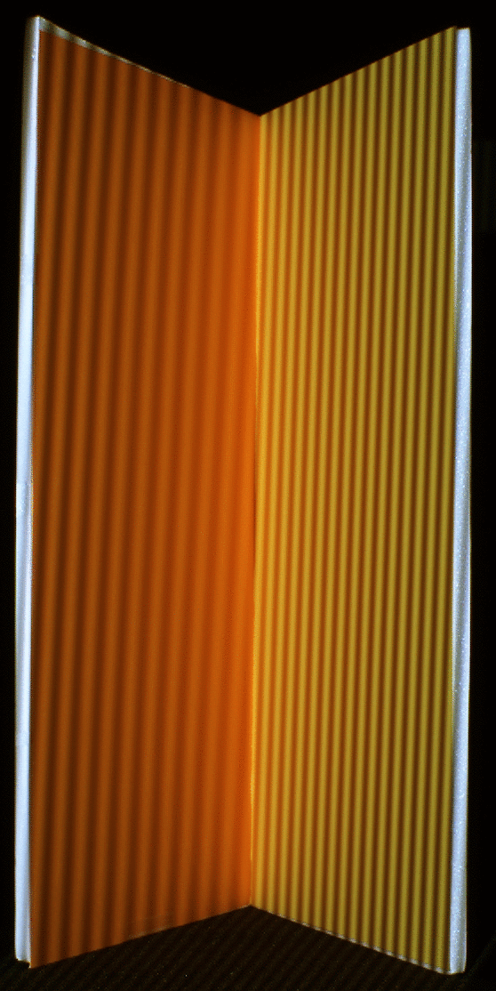

1. V-Groove (Photometric Stereo, N=3)
No Separation
(3 images)
Our Method
(7 images)
Extracted 3 Direct Illumination
Notes:
Here is an example of using photometric stereo for a V-groove

Slide 40
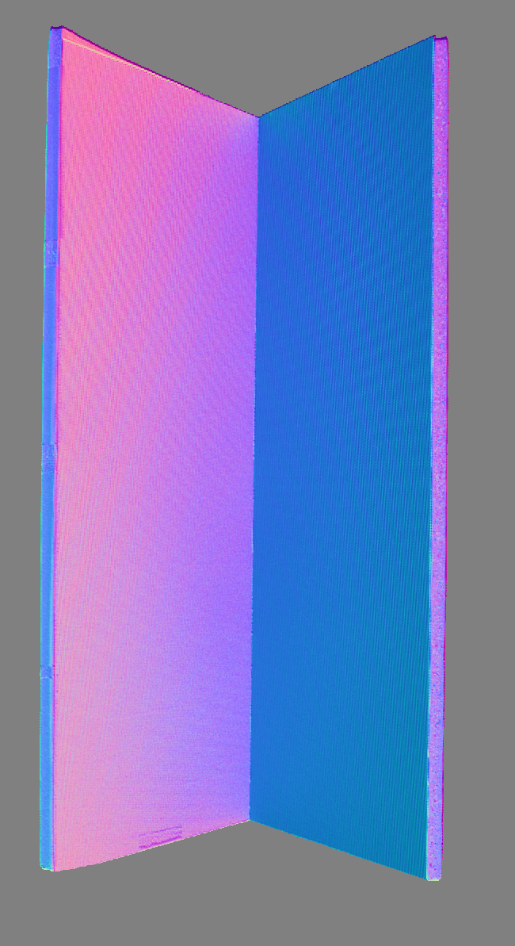
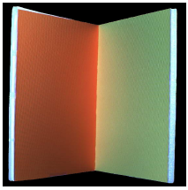
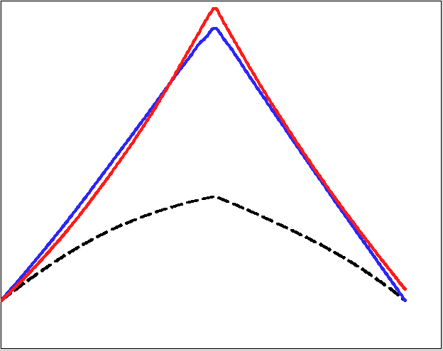
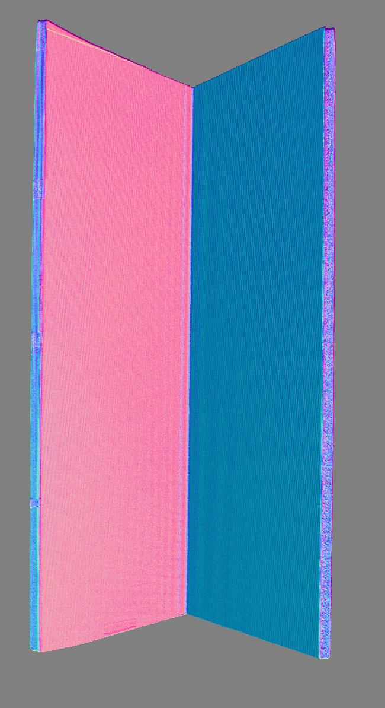
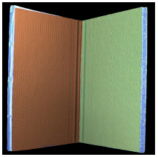
1. V-Groove (Photometric Stereo, N=3)
No Separation
Ground
Truth
Ours
Normal
Albedo
No Separation
Our Method
Depth Profile
Notes:
Here are the recovered results. As shown, with separation we can obtain more accurate surface normals and depths.

Slide 41

2. Christmas Scene (Phase Shifting: N=3)
Fabric
Flower
V-groove
Candle
Notes:
Here is an example of phase shifting to recover scene depth. We construct the scene to include both inter-reflection and subsurface scattering.

Slide 42

Light 1
Light 2
Light 3
Projected
Patterns
Captured
Images
Input: 3*2+1=7 images
Notes:
Here are the input images.

Slide 43
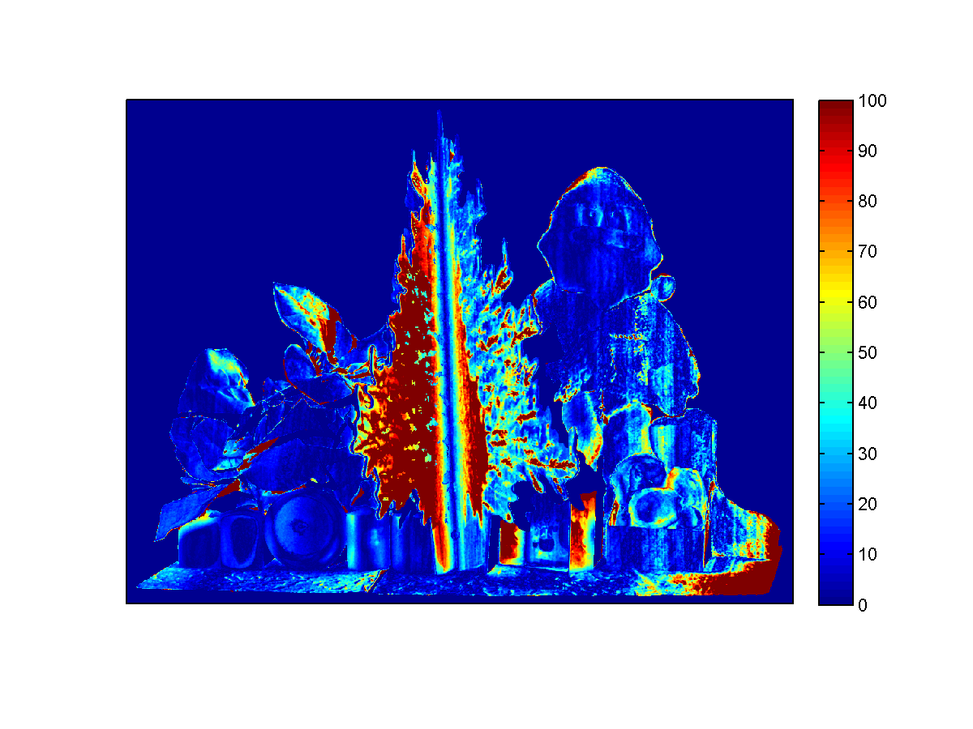
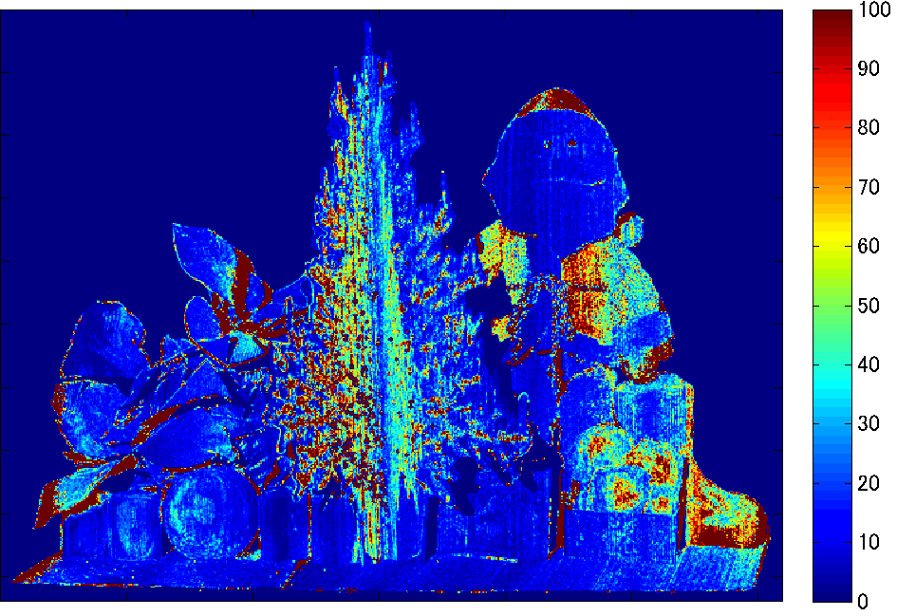
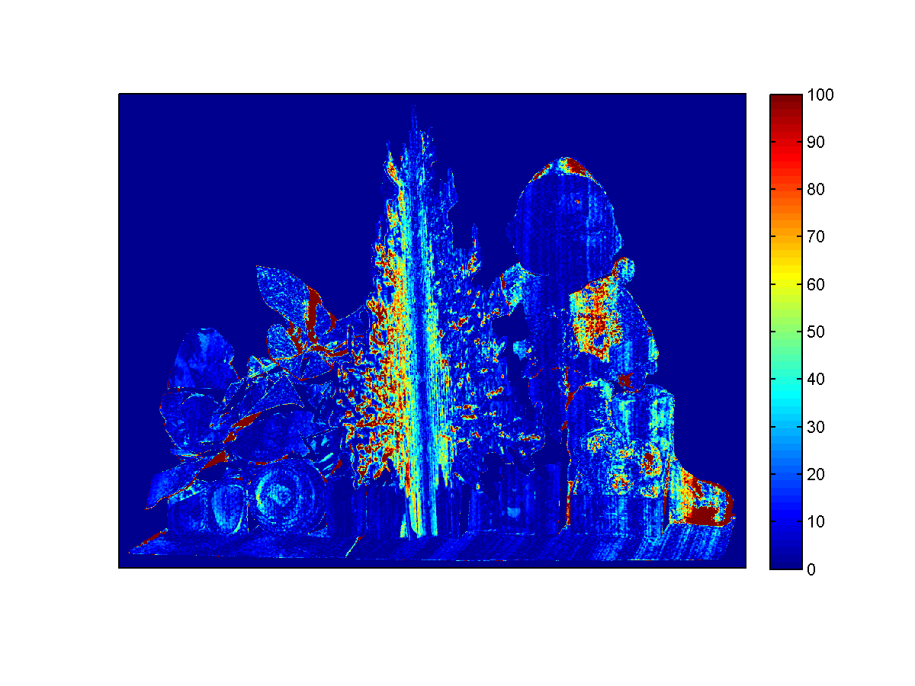
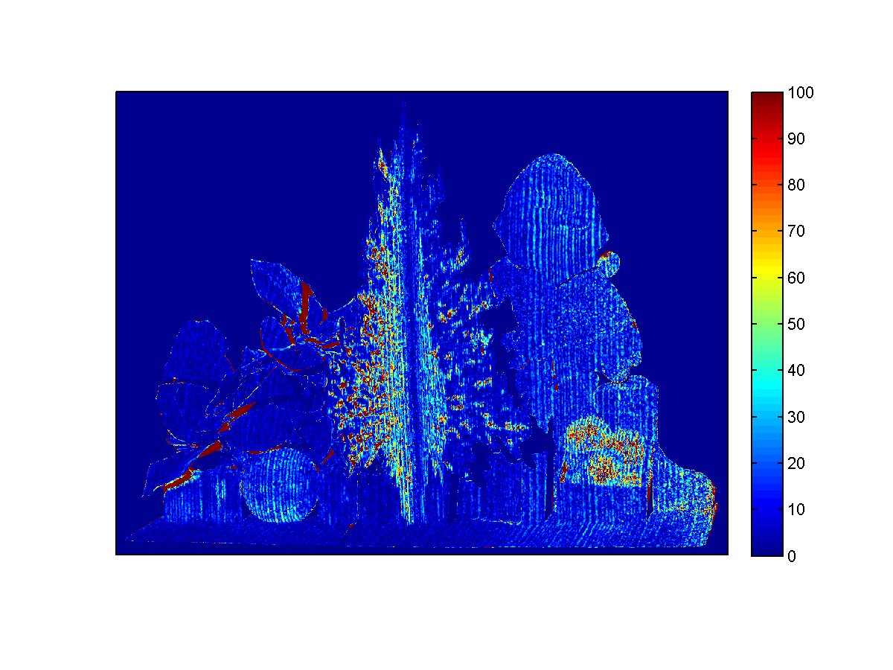
Depth Error (w.r.t Ground Truth)
No Separation
(3 images)
Sequential (Sinusoid)
[Nayar 2006] (9 images)
Sequential (Checkerboard)
[Nayar 2006] (75 images)
Our Method
(7 images)
Notes:
Here are the errors of the recovered depths with respect to ground truth.
As shown, our method obtains the best result, using much fewer images than the sequential separation method.

Slide 44
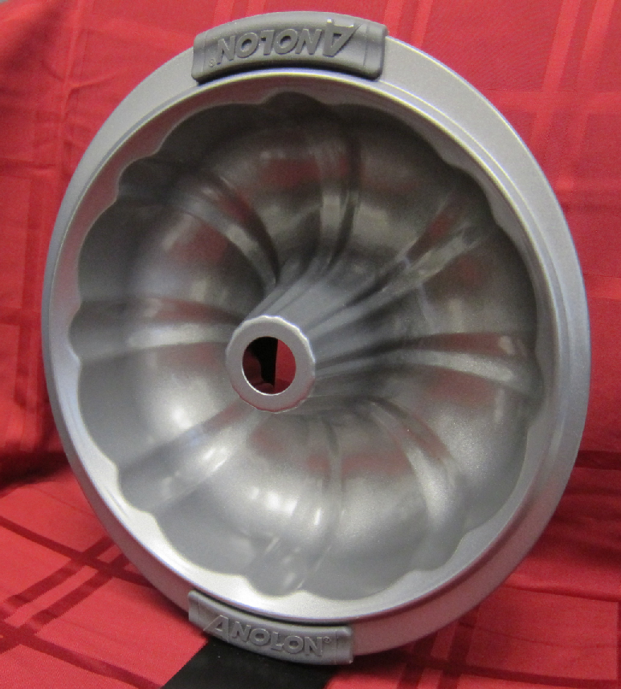
3. Cake Mold (Normal & BRDF, N=9)
Notes:
In the last example, we use 9 light sources to recover the normals and BRDF of a cake mold.

Slide 45
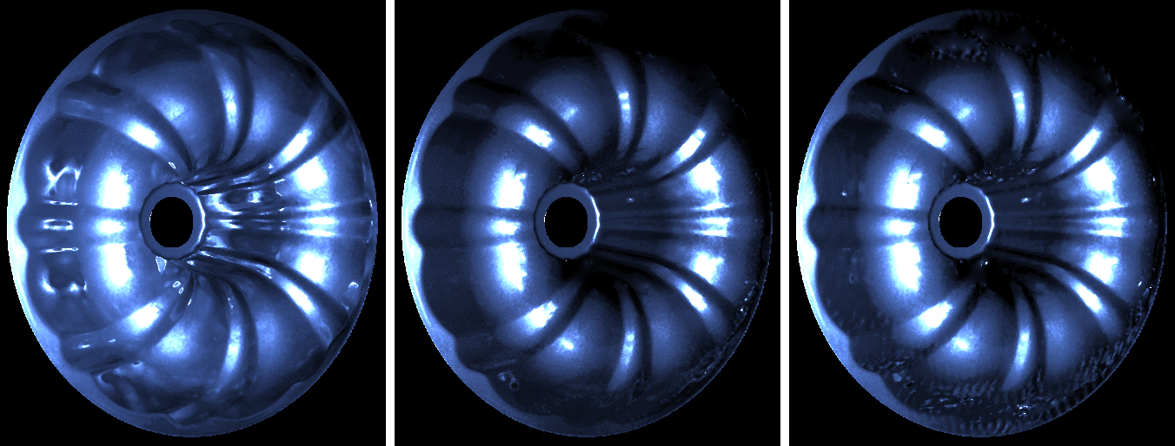
Direct Illuminations of N=9 Lights
No Separation
(9 images)
Our Method
(2*9+1=19 images)
Notes:
Here are the extract direct illuminations.

Slide 46
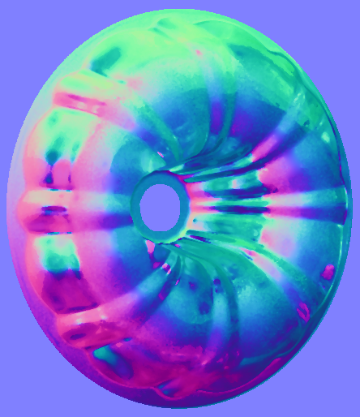
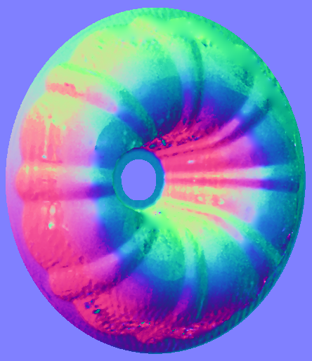
Estimated Normal and Depth
No Separation
(9 images)
Our Method
(2*9+1=19 images)
Notes:
Here we show the recovered normals, and the depth, with respect to the ground truth.

Slide 47
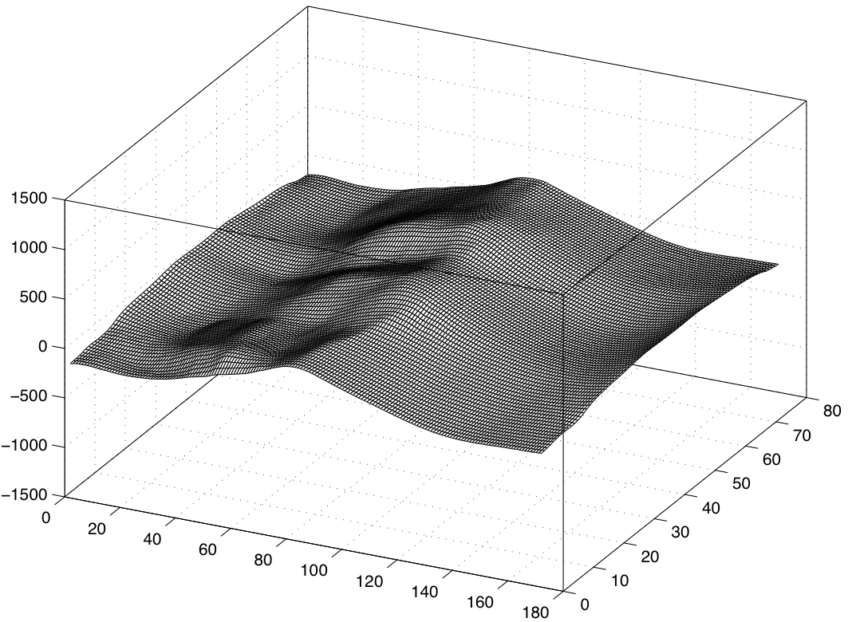
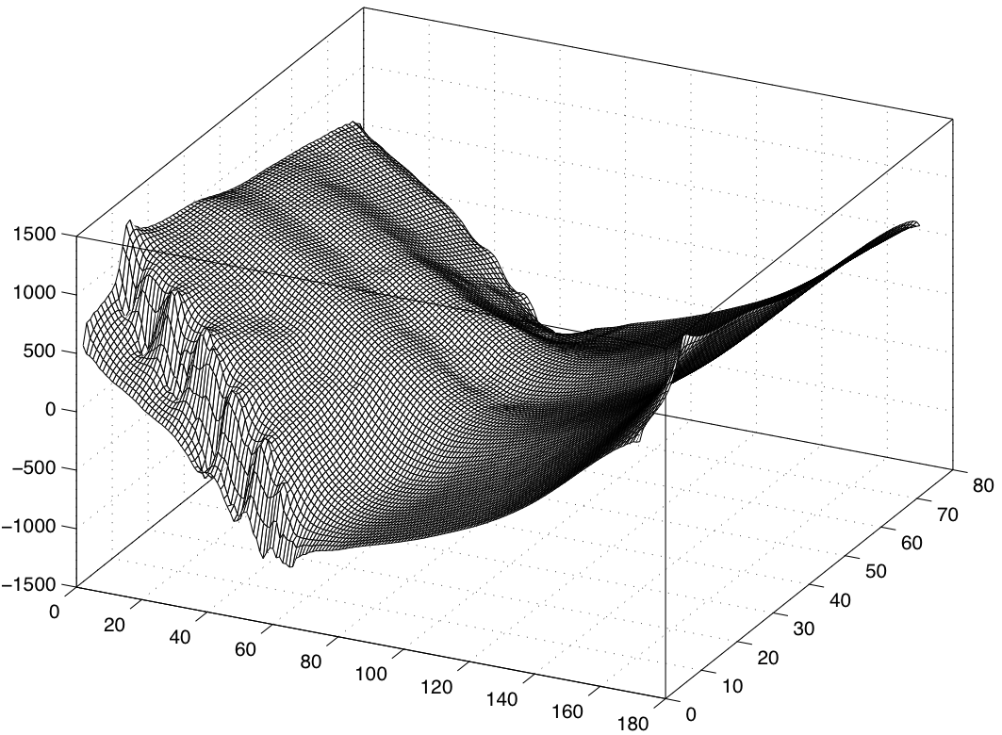
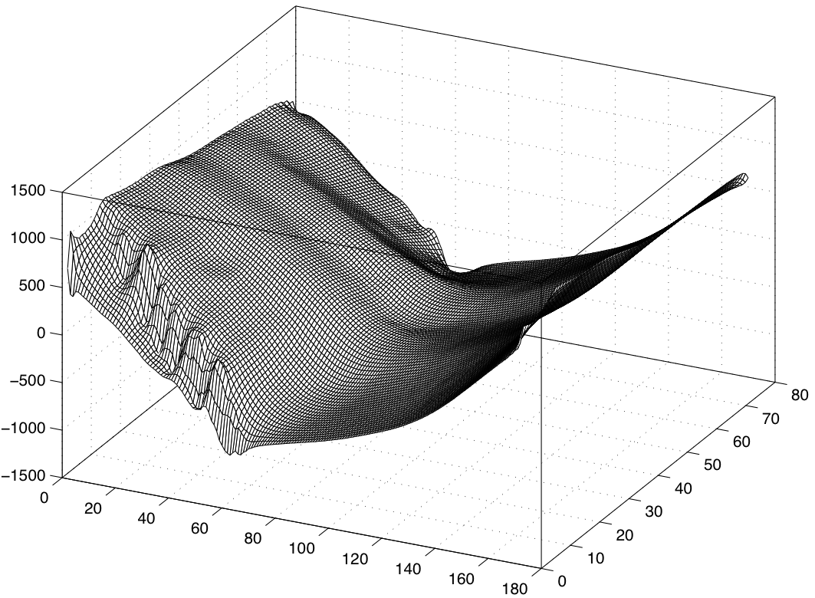
Estimated Normal and Depth
No Separation
(9 images)
Our Method
(2*9+1=19 images)
Ground
Truth Depth
Notes:
Here we show the recovered normals, and the depth, with respect to the ground truth.

Slide 48
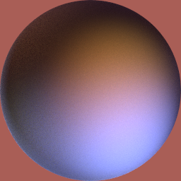
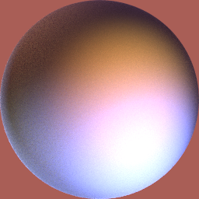
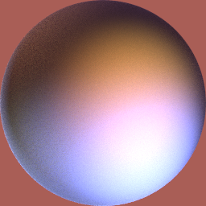
Estimated BRDF
No Separation
(9 images)
Our Method
(2*9+1=19 images)
Ground Truth
Notes:
Here we show the renderings of the recovered BRDFs. Our method obtains much more accurate results.

Slide 49
Summary
We proposed a method to extract direct illuminations for multiple light sources with fewer images.
For dim light sources, the proposed method has SNR advantage because of illumination multiplexing.
More experimental results are:
http://www.cis.rit.edu/jwgu/research/demux
Notes:
More experimental results can be found at our project webpage.
In summary we proposed a method to extract direct illuminations from multiple light sources with fewer images.
We showed that for dim light sources, the proposed method has SNR advantage because of illumination multiplexing.
Pause for 5 seconds.

Slide 50
Global Illumination Can Be Useful.
Notes:
So far, we have considered global illumination as noise – something which needs to be removed.
But if we think about it, global illumination can be useful. It encodes intra-scene optical interactions. If we can recover global illumination, we can learn a lot of things about the scene.

Slide 51
Future Work: Using Global Illumination for Scene Recovery
Scene
Direct Component
Global Component
Notes:
Here is an example. This is a scene with a variety of organic materials, fruits and vegetables. The global component image is really beautiful to look at…
From a computer vision point of view, this separation is useful as well. It can be used to make material and geometric inferences about the scene. For the fruits, we can notice that the global component is much higher as compared to the direct component. This is because of sub-surface scattering. It indicates presence of translucent materials. We can notice high global component between the eggs. This is because of inter-reflections. It indicates presence of local concave structures.

Slide 52
Future Work: Decomposing Global Illumination
Volumetric Scattering
Inter-reflections
Direct Illumination
Sub-surface scattering
Light Source
Scene
Notes:
Now, we know how to separate the direct and global components. In the future, we want to decompose global illumination further into its various components – interreflections, subsurface scattering and volumetric scattering, as each component tells us something different about the scene.
The message that I would like to leave you with is that there is a lot of information hidden in these light transport effects. We are trying to figure out how to extract it. Once we do, we will have taken significant steps towards building vision systems which can understand the scene.
Thank you very much, and I will be happy to take any questions.

Slide 53
Future Work: Decomposing Global Illumination
Volumetric Scattering
Inter-reflections
Direct Illumination
Sub-surface scattering
Light Source
Scene
Notes:
Now, we know how to separate the direct and global components.

Slide 54
Future Work: Decomposing Global Illumination
Volumetric Scattering
Inter-reflections
Direct Illumination
Sub-surface scattering
Light Source
Scene
Notes:
In the future, we want to decompose global illumination further into its various components – interreflections, subsurface scattering and volumetric scattering, as each component tells us something different about the scene.
The message that I would like to leave you with is that there is a lot of information hidden in these light transport effects. We are trying to figure out how to extract it. Once we do, we will have taken significant steps towards building vision systems which can understand the scene.
Thank you very much, and I will be happy to take any questions.

Slide 56
Summary
A theoretical lower bound
N+1 images are needed for extracting the N direct illuminations for N light sources.
An optimal Frequency Modulated Multiplexing scheme
2N+1 images are sufficient for extracting the N direct illuminations for N light sources
SNR analysis of illumination multiplexing in the presence of global illumination
sqrt(N) SNR gain if read noise dominates
2/3 SNR gain if photon noise dominates
Notes:
Xxx
Multiple light sources
If we only care about the direct illumination, can we do better?
Two key insights:
Global illumination stays unchanged, as long as high frequency patterns are …
Multiplexed illumination can have SNR benefits …

Slide 57
Limitations & Future Work
Only direct illumination components are extracted.
The use of the recovered phase maps.
What is the minimal number of images required, for different types of scenes?

Slide 58
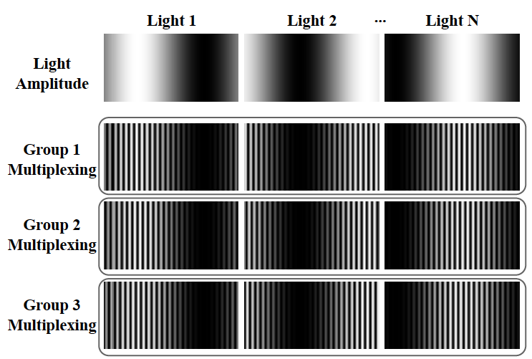
Conventional Hadamard Multiplexing for Direct/Global Separation

Slide 59
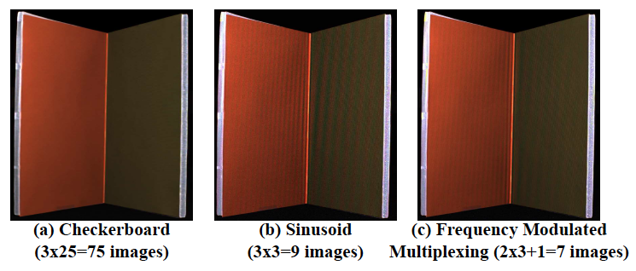
Experimental Comparison
Frequency modulated multiplexing needs fewer images while provide a better estimate for direct illumination.

Slide 60
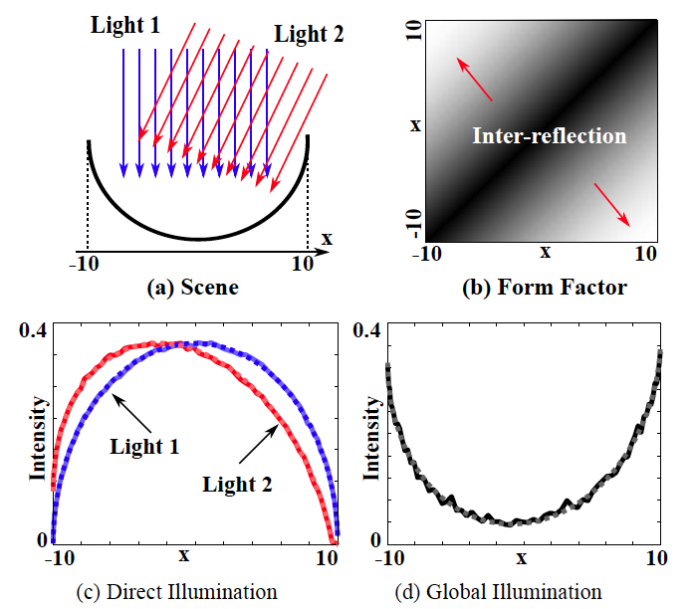
Simulation Results
Ground truth global illumination is estimated by radiosity

Slide 61
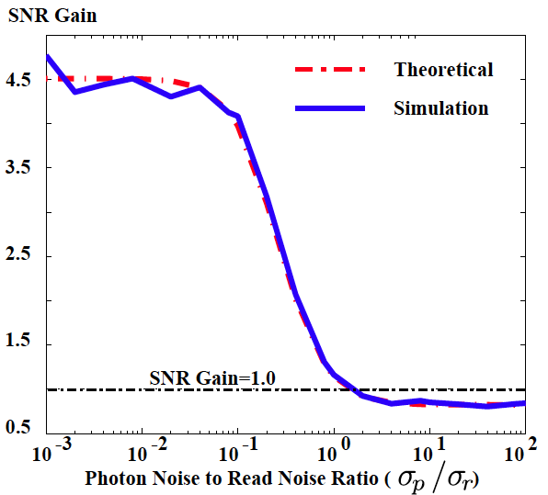
SNR Analysis: Simulation Results
N=30 lights

Slide 62

Input Images
Sequential Separation
with Sinusoid
[Nayar 2006]
(3*3=9 images)
Sequential Separation
with Checkerboard [Nayar 2006]
(3*25=75 images)
Our Method
(3*2+1=7 images)

Slide 63








Evaluation (Read Noise)
Noise
0.005
0.01
0.02
0.05
Sinusoid
Sequential
(3N images)
SSIM
0.86
0.77
0.57
0.21
Frequency
Modulated
Multiplexing
(2N+1 images)
SSIM
0.88
0.86
0.77
0.46

Slide 64








Evaluation (Photon Noise)
Noise
0.005
0.01
0.02
0.05
Sinusoid
Sequential
(3N images)
SSIM
0.88
0.85
0.74
0.43
Frequency
Modulated
Multiplexing
(2N+1 images)
SSIM
0.88
0.83
0.71
0.36

Slide 65
SNR Analysis
Similar conclusions as conventional light multiplexing
Require fewer input images (2N+1), and thus faster
Compared to
SNR Gain
Read
Noise:
Dim
Scenes
No Multiplexing
(3N images)
Photon
Noise:
Bright
Scenes
SNR reduces by
Conventional
Multiplexing
(3N images)
(Please refer to the paper for detailed derivation.)
Notes:
$\mbox{Trace}\left((\mathbf{F}^T\mathbf{F})^{-1}\right)-(\mathbf{F}^T\mathbf{F})^{-1}_{2N+1,2N+1}=\frac{4N}{2N+1}$

Slide 66












Light 1
p=0
Light 2
Direct Illumination
p=2/3π
Light 3
p=4/3π
No Separation
Sequential Separation
[Nayar 2006]
Our Method

Slide 67


(Sum of) Global Illumination
Sequential Separation
[Nayar 2006]
Our Method

Slide 68

4. Pop-up Book (Phase Shifting, N=3)

Slide 69

Light 1
Light 2
Light 3
Projected
Patterns
Captured
Images
Input: 3*2+1=7 images

Slide 70




Depth Maps
Ground Truth
No Separation
Checkerboard
[Nayar 2006]
Our Method

Slide 71



Depth Errors (w.r.t. Ground Truth)
No Separation
(3 images)
Sequential Separation
with Checkerboard [Nayar 2006]
(3*25=75 images)
Our Method
(2*3+1=7 images)

